Slide 1
Advanticsys
Weekly update – 19/05/2023
Overview of outcome from implemented prediction models
Teamwork and roles for 3 of us
Plan for completing all works by next Friday

Slide 2
Machine Learning Results
Inverter | RMSE
Inv01 | 0.67
Inv02 | 0.62
Inv03 | 0.74
Inv04 | 0.44
Inv05 | 0.52
Inv06 | 0.74
Inv07 | 0.76
Inv08 | 0.77
Inv09 | 0.68
Inv10 | 0.73
Isolation forest performs deep cleaning of the data.
The data categorized as normal is being fed to the multi layer perceptron(MLP) for training.
The MLP consists of 1 input layer, 2 hidden layers and 1 output layer.
There will be 10 models since the configuration of the inverters are assumed to be different.

Slide 3
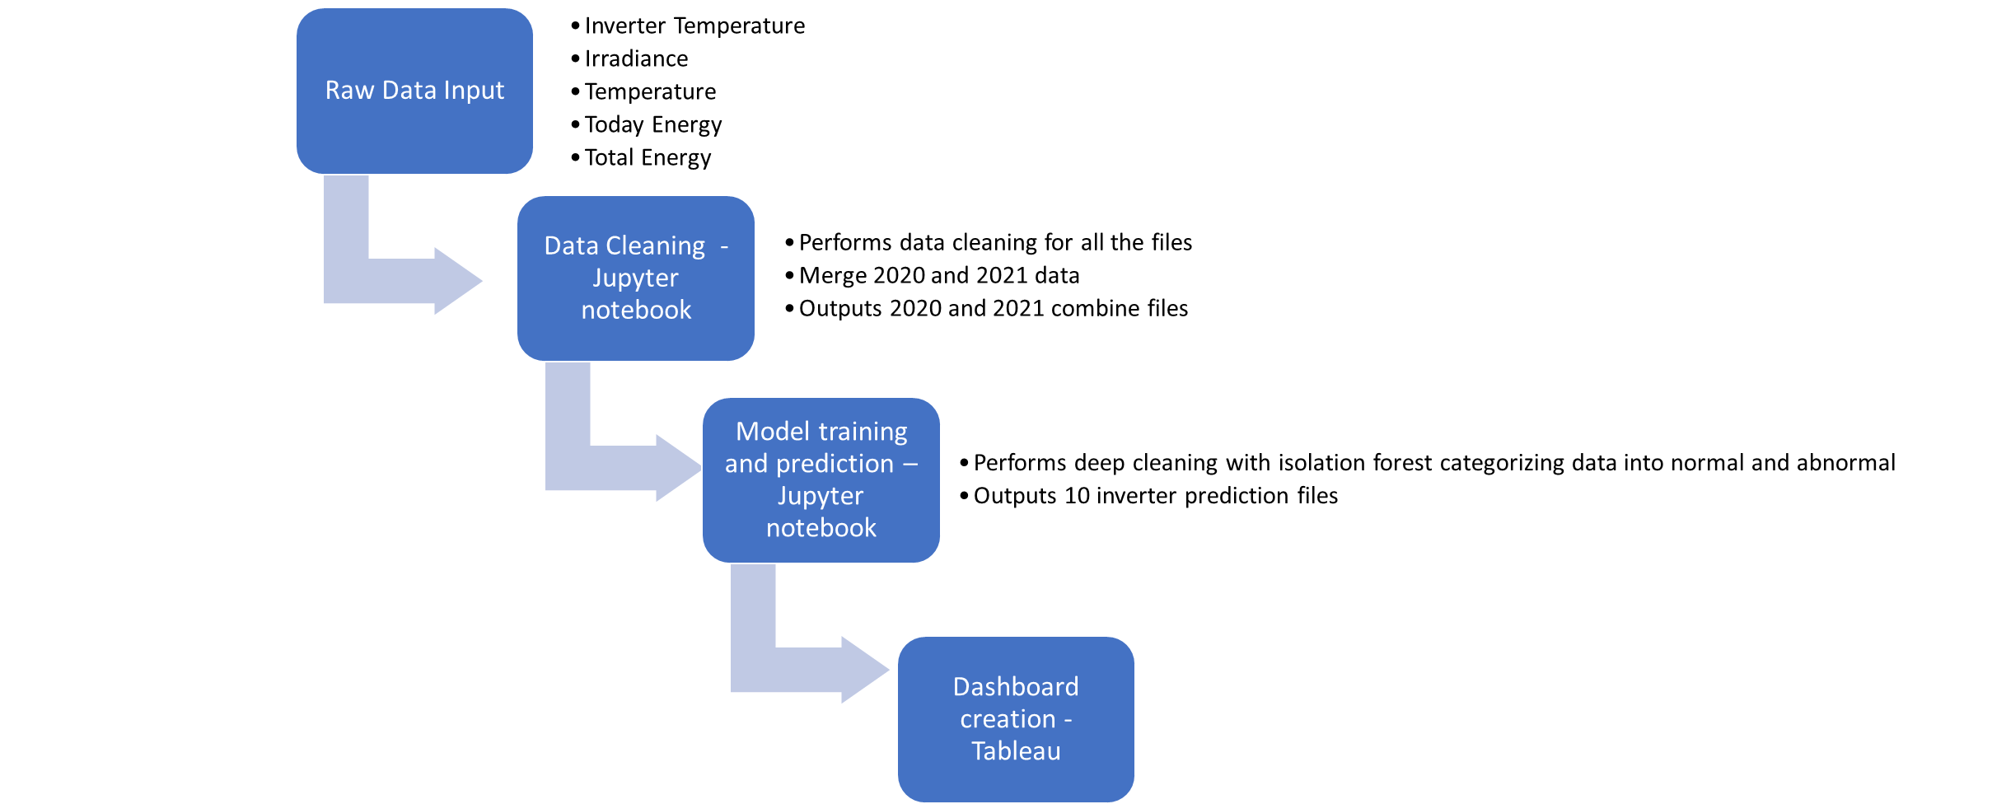
Data Feed and Execution
Created using clean actual data and predicted data

Slide 4
Teamwork through the semester
As a group, we worked together to understand the project and deliver outcomes
We have regular meeting in person each Wednesday as well as online meetings each week
In each group meeting, we share own findings from the data and analysis, brainstorming and find possible solutions for roadblocks
Discuss and assign upcoming tasks after Friday meetings
Apart from teamwork, we also worked in different roles to make sure we deliver outcomes smoothly and efficiently

Slide 5
Qi Lu
Leader of the team
Focus on the aim and drive the project to cover all possible aspects
Designed the abnormal detection process and set strategic plans to follow it closely trough time
Responsible for making decisions when assumptions tested wrong and seek new approach when necessary, make sure all works contribute to the final goal
I have worked with team to assign tasks to get outcomes in time
Also, made sure team understand the importance of statistical analysis on actual data, conduct hypotheses testing and provided insights based on available data
Communicate and receive feedbacks from partners and professor constantly
By working with the team, I have learnt new ML techniques and applications

Slide 6
Joyal Joy Madeckal
Leader of technology
Focus on managing and working with technology to provide sound technical support
Responsible for data exploration cleansing.
Combined all data together to identify patterns and correlations between variables, made raw data meaningful and useful
Conduct assessment on ML models, setup foundation for ML technology implementation and make sure prediction on core figure is achievable
Provide deep research on different methods to find an ideal solution in line with project aim
With the team, I have deployed Isolation Forest and Multi Layer perceptron ML techniques
With this task, I am aware of the new Isolation forest technique

Slide 7
Denis Vaghasia
Leader of operation
Focus on finding and using suitable tools to deliver a functional product in a tight time frame
Responsible to make sure all the strategic plans are implemented and executed through all stages of the project, convert plan to reality
My task was to merge the different part of project i.e., combine outcomes from statistical analysis and machine learning model into one set
Another task was creating the final product, create a functional Tableau dashboard for data visualization and story telling to show possible abnormal and support decision making
Additionally, deployed LSTM model which was eventually scratch due to change in approach
By working with the team, I was able to explore possibilities of Tableau and new ML technique

Slide 8
Plan for next week
Try to complete working files building
Save all useful files onto GitHub, provide links to the files
Provide explanation and instruction on working process
Summaries the works we have done and achieved in each week for the past 10 weeks
Demonstrate the dashboard we have built that can identify abnormal
Give a complete presentation on next Friday 26/05/2023

